Slide 1
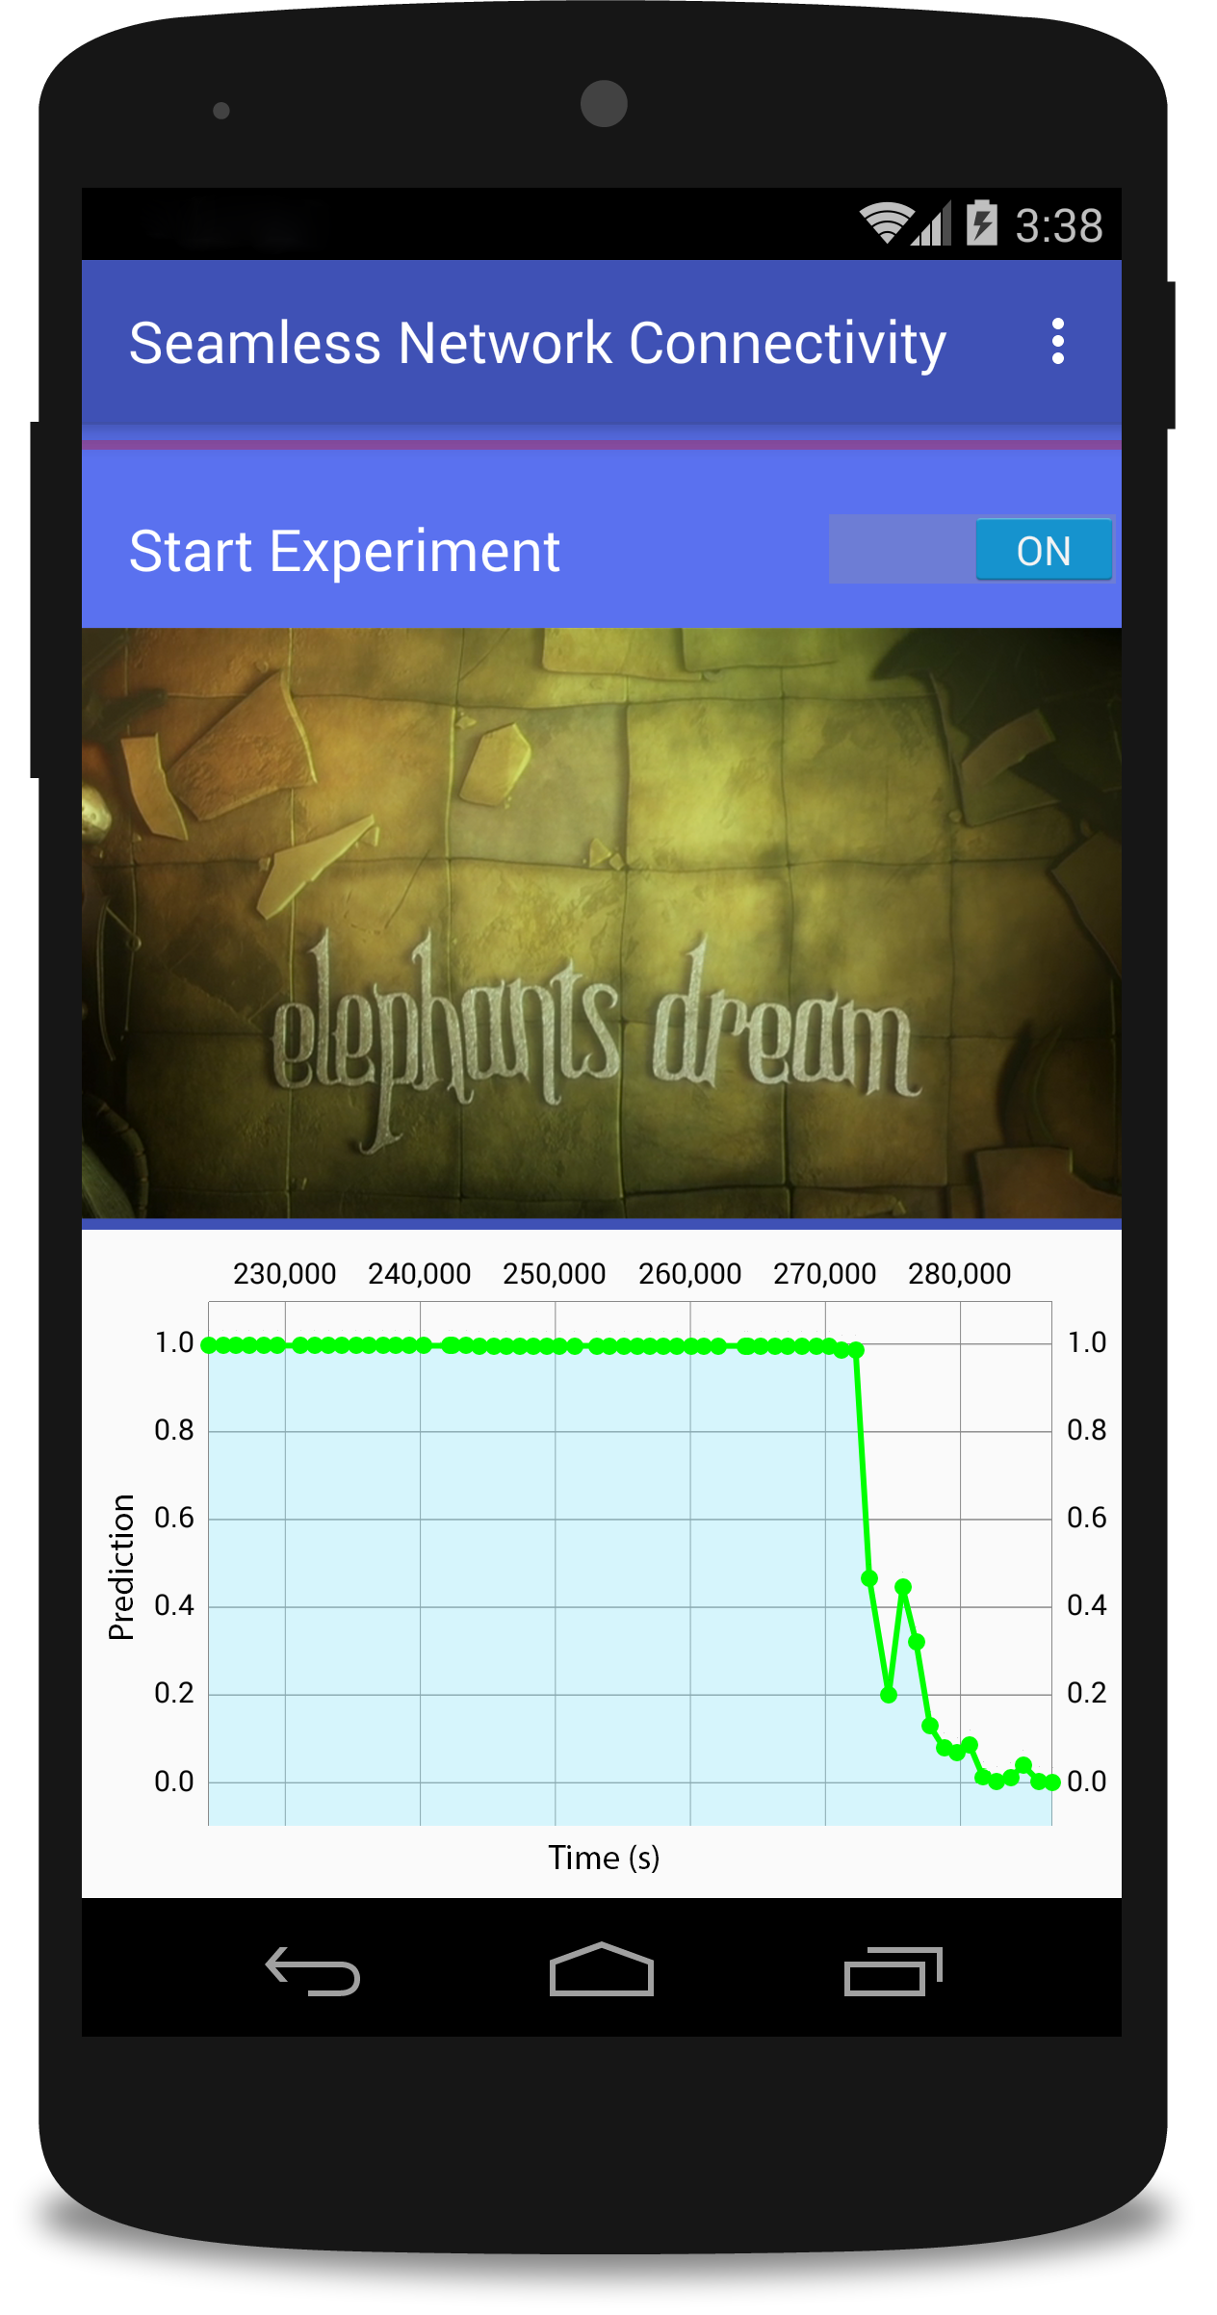
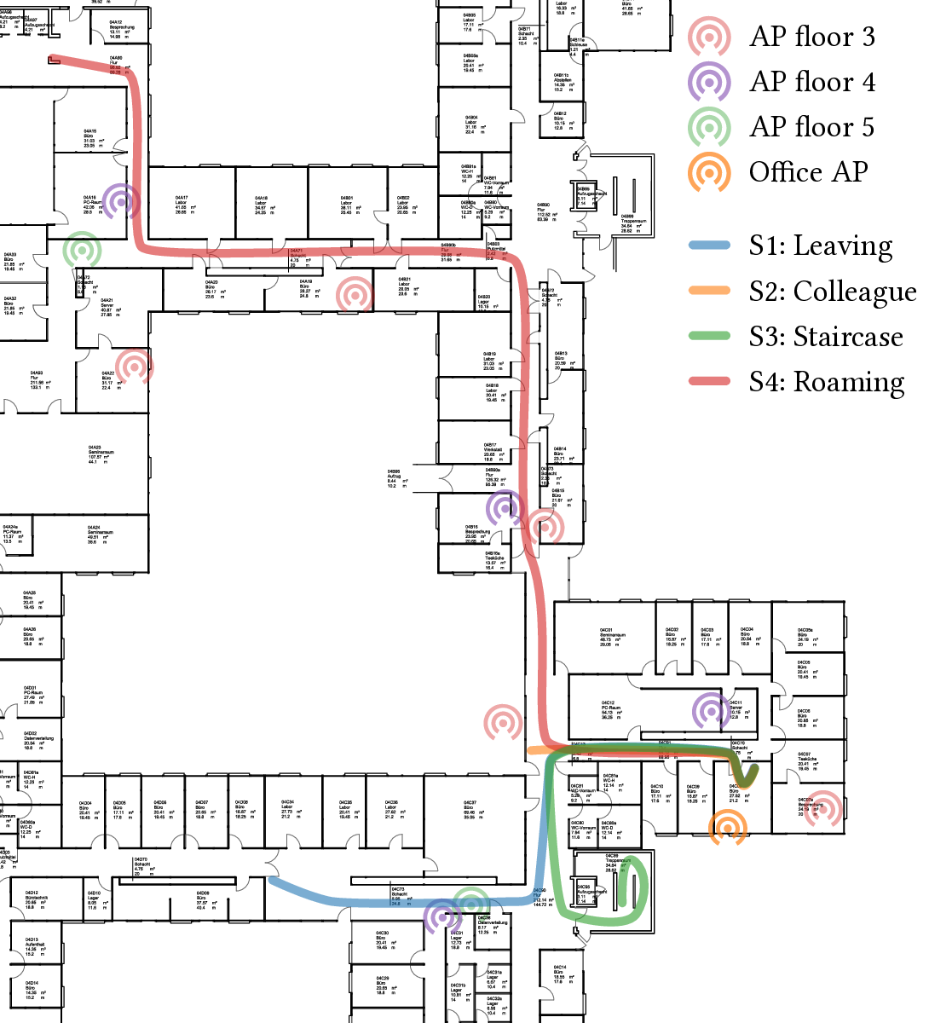
Learning Wi-Fi Connection Loss Predictions for Seamless Vertical Handovers Using Multipath TCP
Jonas Höchst, Artur Sterz,
Alexander Frömmgen, Denny Stohr,
Ralf Steinmetz, Bernd Freisleben
TU Darmstadt and Philipps-Universität Marburg
Notes:
Introductional Example:
- Leaving Home in the Morning
- Having a VOIP call, other live applications
- Wi-Fi connection is lost
- Stallings in the Applications, Buffering; even triggers User-Interactions

Slide 2
Introduction: Smartphones - Daily Companions
Communication
Information
Entertainment
Wi-Fi
Cellular
→ Handover
Notes:
Multiple Radio Access Technologies – Wi-Fi / Cellular
Different Characteristics in Availability,
Energy and Economical perspectives (e.g. Data Plans)
Handover Scenarios are common during Workday: Home - Car - Office - Park - …
Smartphones are not ready to perform handovers efficiently.

Slide 3
Introduction: Vertical Handovers Today
Handovers are performed reactively:
    Based on weak RSSI or high packet loss
    Change of default gateway
      Application has to deal with connection loss
  Multipath-TCP enables seamless handovers
    Multiple subflows on all available network interfaces
    Drawback: energy usage, use of limited data plans
Notes:
- Operating System decides when a Wi-Fi connection is bad
- Applications gets no further notice and has to deal with that
Multipath-TCP to the rescue
- Multiple subflows, fast migration
- But: All interfaces have to be in an active mode, and subflows have to be enabled

Slide 4
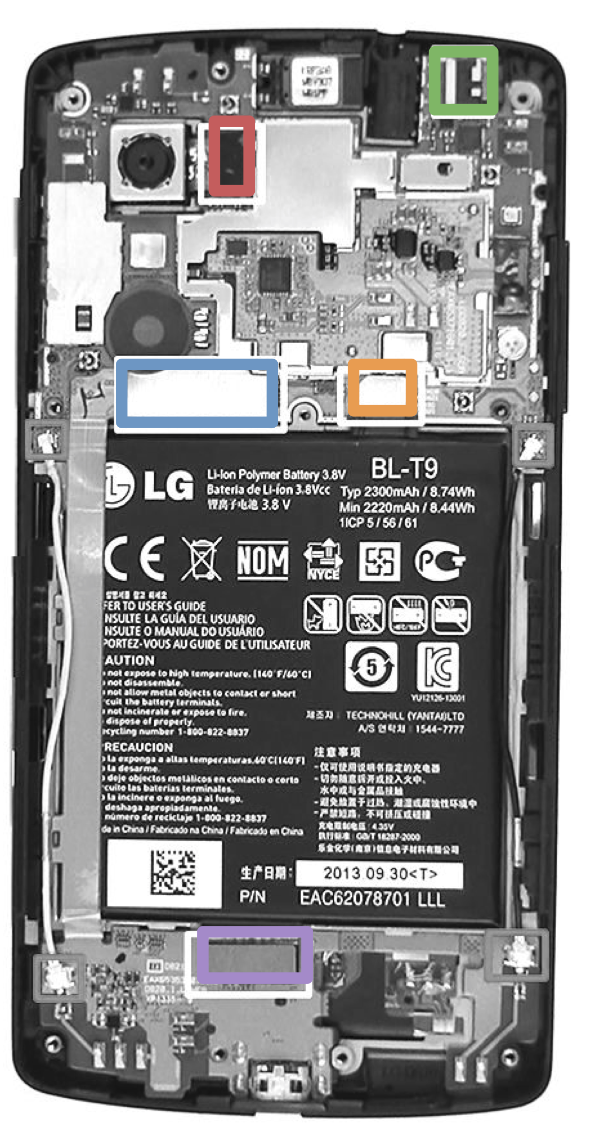
Introduction: Contributions
Novel data-driven, proactive approach for seamless vertical Wi-Fi/cellular handovers
  Multiple heterogeneous smartphone sensors to predict Wi-Fi connection loss
  Multipath-TCP based seamless connection handover
  Experimental evaluation based on Quality of Experience
  Open demo implementation and experimental artifacts

Slide 5
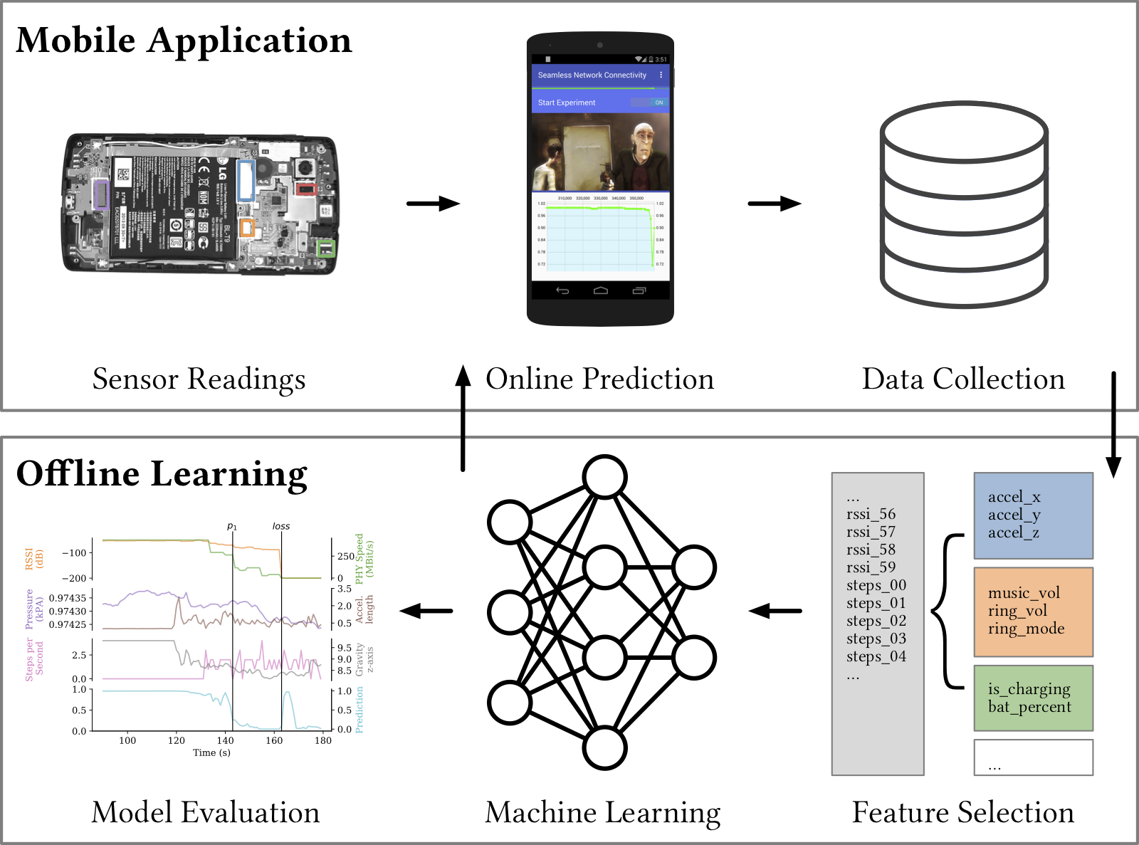
Conceptual Overview
Notes:
All possible sensor readings are taken
Collection of sensor readings across different useers
Features are selected using expert knowledge
Our approach to prediction
Machine Learning to implement the prediction
Model evaluation to select the best available models.
Online Prediction
and Experimental Evaluation using QoE mechanisms

Slide 6
Smartphone Sensor Readings
Wi-Fi Properties Linear Acceleration
Spatial Orientation Ringer Mode
Wi-Fi Access Points Power State Magnetic Field Audio State
Step Counter Bluetooth Neighborhood
Gravity Atmospheric Pressure
Notes:
- Motion – user movement
- Orientation – in the pocket or laying on table
- Power State - is the phone charging?
- Magnetic Field - non-radical changes, e.g. in the car
- Atmospheric Pressure - Up to centimeter-wise height measurements

Slide 7
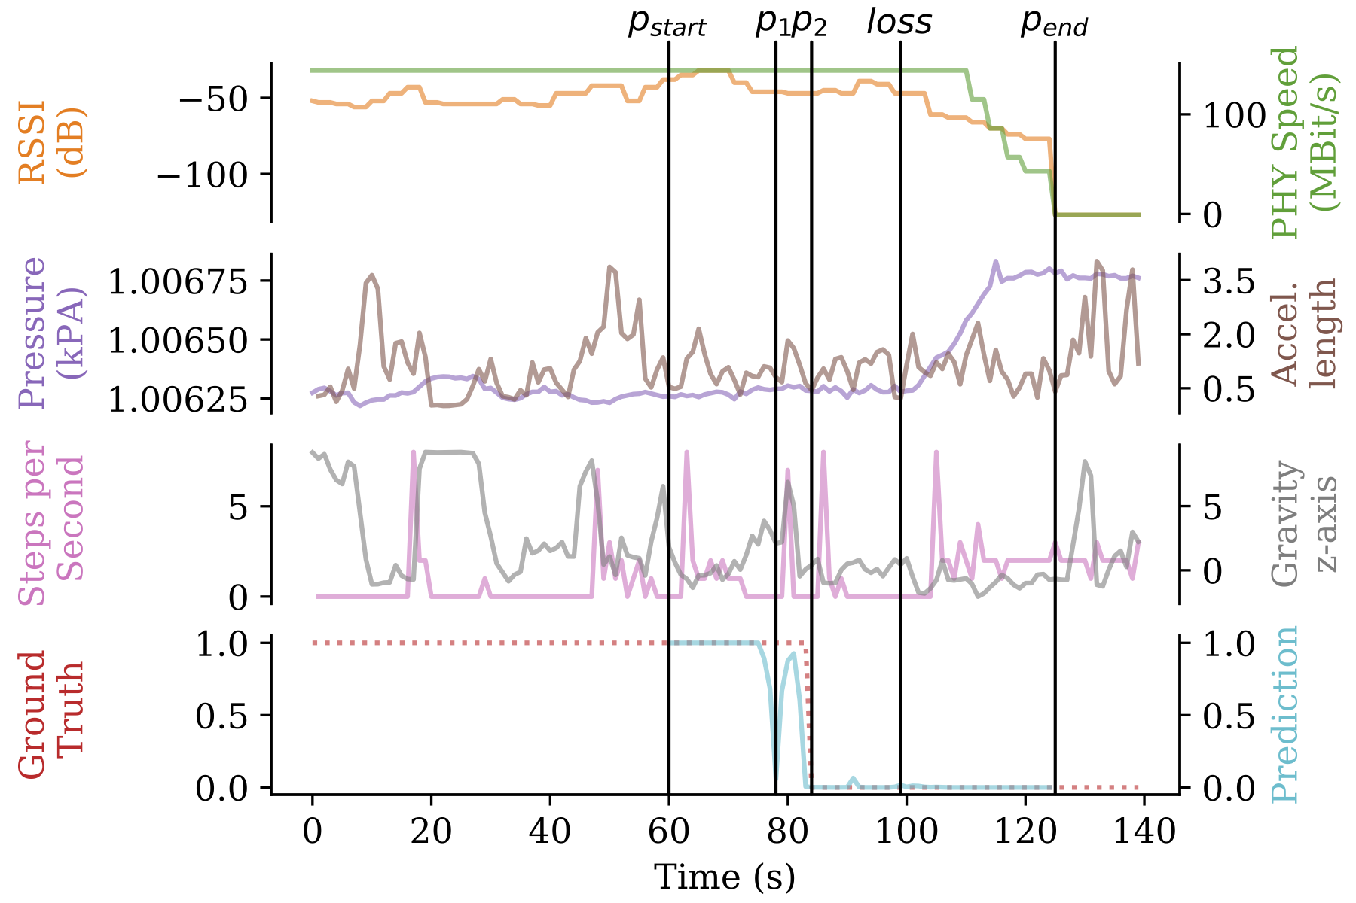
Sensor Data Example
Notes:
6 Sensors:
- RSSI and PHY speed, of WiFiData API
- Pressure: 100 – 120 sec: significant change -> staircase
- Acceleration: Movement is ongoing
- Steps per second: User is walking, variing sample rate
- Gravity: e.g. 20 – 30 sec: laying flat on the table
Examples:
- pressure t=100 – 120 -> changing floors or ventilation?
- step counter -> changing floors!
Come back to that later…

Slide 8
Data Collection
20 GB of sensor data from five different users
    Running for the whole day – daily lives of users
900,000 unique samples, collected in three months
Training and test set
    Random split of all available samples (70:30)
    User-based split: learn with some users, test with the others
Notes:
User-based split: testing how good the network is able to generalize across users

Slide 9
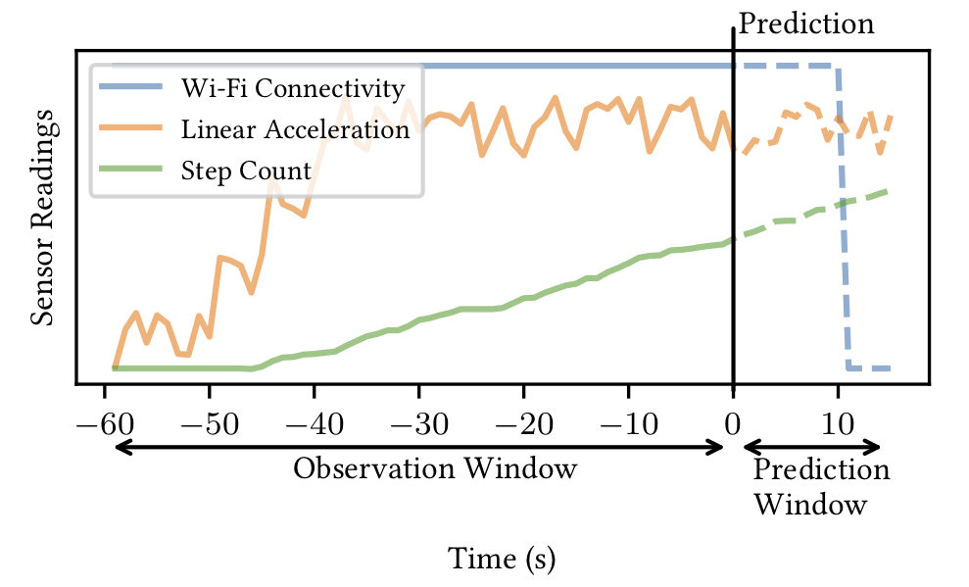
Feature Selection: Observation & Prediction
Notes:
How to predict?
- Example sensors here, no real data
- Observation Window: use all the samples
- Prediction window: aggregate the status over 15 seconds
- 15 seconds: connect LTE, build up subflows, user mobility (average time to leave Wi-Fi)

Slide 10
Feature Selection: Input Vectors
Full Feature Vector
    All 25 available sensors, 25 x 60 = 1500 features
  Reduced Feature Vector
    Atmospheric pressure, linear acceleration, power,
    step counter, gravity, Wi-Fi (frequency, speed, RSSI)
    8 x 60 = 480 features
  Ground Truth
    Wi-Fi RSSI > -70 dBm, shifted
Notes:
Atmospheric pressure: delta; Linear acceleration: delta; Step counter: delta, Power: is charging, Gravity: z,
Wi-Fi: frequency, speed, RSSI. (8 x 60 = 480 features)
Reduces: through extensive experiments we found most useful features

Slide 11
Machine Learning: Random Forest
  Requires equally distributed samples:
  down-sampling, 10 random trees
  Table: Random Data Split, Reduced Feature Vector
Notes:
Random Forest: Baseline, fast, goto ML for simple tasks for many applications
Example: Random Data Split, Reduced Feature Vector
High loss recall (0.98), rather low loss precision (0.86)
Most losses are predicted, but there are a lot of unnecessary handovers

Slide 12
Machine Learning: Neural Networks
  Input Layer: up to 1500 neurons, depending on feature vector
  Hidden Layers in different configurations:
    NN 1: 1 hidden layer of (100) neurons
    NN 2: 3 hidden layers of (300, 200, 100)
    NN 3: 5 hidden layers of (400, 400, 400, 400, 400)
  Output Layer: 1 neuron, indicating loss probability
Notes:
Proposed Networks defined by experiments
3 different Networks shown here
Efficiency vs. Quality

Slide 13
Model Evaluation: Random Data Split
Table: Reduced Feature Vector, Random Data Split
Notes:
Only Prec. / Recall of Loss class
NN 1 overall comparable to Random Forest
NN 2 and NN 3 comparably good
Neural Network performs well for both cases, F-Score of 0.96
User-based split also evaluated, available in paper
=> ARTUR

Slide 14
Model Evaluation: Example
Notes:
Sensons as in the previous example
p_start: start of classification (observation window filled)
p_end: end of classification (no Wi-Fi connection, as reported from OS)
loss: the actual Wi-Fi connection loss, computed from shifting RSSI, and applying threshold
Ground truth: 0 if in the next 15 seconds the loss occurs
No correlation a single factor and the Ground Truth
- p_1: early loss prediction
- p_2: perfect prediction

Slide 15
Online Prediction: Mobile Application
On-Device Model Execution
DASH.js Video Playback
MPTCP Handovers
Notes:
For eval, we built android app
Parts: on device model exec
Video player as use case
Handovers using mptcp
For model exec: transpile trained models to native Java code using common tools and custom code generator for data processing
Transpiled to dalvik byte code for fast execution

Slide 16

Online Prediction: DASH.js Video
Dynamic Adaptive Streaming over HTTP(s)
    Configuration: BOLA adaptation algorithm, 10 s buffer
    H.264 video, AAC audio
    Segments of 2 seconds
    Available bandwidths: 1, 2, and 4 Mbit/s
  Base metrics: Stalls, Bitrate, Adaptations, Buffer levels
Open Movie:
Elephants Dream
Notes:
Video player using dash.js
Go through config
Metrics: #stalls, stall duration, bitrate (ie quality), adaptations, buffer level
Which movie

Slide 17
Online Prediction: MPTCP Handovers
Toggle LTE state based on online prediction
  MPTCP kernel implementation (v0.86) for Android
  MultipathControl (De Coninck et al.)
  Video server: MPTCP v0.92
    redundant scheduler
    fullmesh path manager
Notes:
How are handovers are implemented:
Compiled mptcp kernel to android
Based on prediction, toggled lte state between cellular data on and off
Multipath control app observed state andadjusted default routes accordingly -> also, prevents wifi turning off if LTE enabled
Summary: if predicted wifi drop, turn on data over lte and let mptcp handle the handover.
Server config:
Redundant scheduler: send all data on all subflows -> get as much data as possible for the best video quality possible.
Fullmesh path manager: set up subflows on all interfaces

Slide 18
Experimental Evaluation: Scenarios
Four scenarios:
    Leaving the office (1)
    Visiting a colleague (2)
    Using the staircase (3)
    Wi-Fi roaming support (4)
Three connectivity modes:
    Android, MPTCP, Seamless
  Nexus 5, Android 4.4.2
Notes:
Four scenarios (show on map):
Leaving office -> the main scenario, just lose wifi
Visiting colleague -> similar scenario, but wifi won’t drop -> see, if we trigger false positives
Staircase -> still in wifi, but quality is too bad -> we want also handovers here! → Also use more sensors
Wifi roaming -> university building, hop from ap to ap, how does our prediction handle this?
Three connectivity modes:
How does stock android perform?
MPTCP only
Our approach
Everythin built on nexus 5 using Android 4.4.2 due to kernel restrictions

Slide 19
Online Prediction
Demo
https://youtu.be/E0CFLk82s6s
Notes:
At this point we want to show you a demo, but we have a problem.
To get the picture from the phone to the screen, we need a wireless connection, because we have to move.
But the goal is to lose the wireless connection, which is contradictory.
But we have found a way to show you our approach in action. -> click link

Slide 20
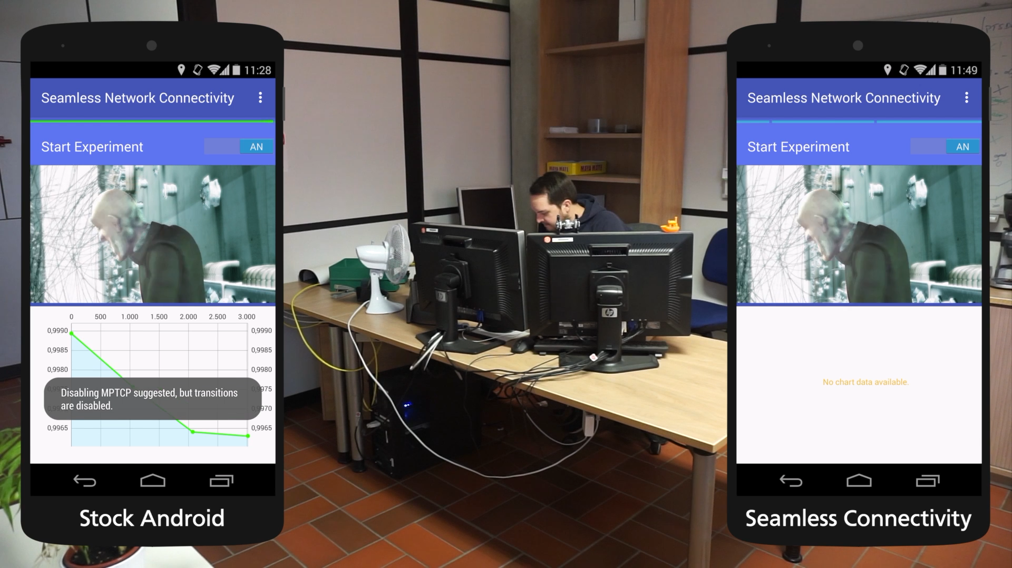
Notes:
Recorded video showing scenario 1: leaving the office
Left: stock android, right: our approach
Upper part: video, lower part: vizualisation of our prediction
1: we won’t lose wifi, 0: we will lose wifi within next 15 seconds
Threshold: 50%
Y-axes not fixed
Start the experiment by leaving the office
At the beginning, the prediction yields more than 90%
After aroung 10-15 meters, our prediction suggests to enable mptcp on the left and triggers the handover on the right
On the right, you can see that the routes are changed, and network properties are adjusted
On the left, you can see, that the video is stalling -> even though the wifi indicator is showing, that we still are connected to the ap
On the right, the video is still playing.
STOP!

Slide 21
Experimental Evaluation
Overview of Experimental Results
Notes:
Tables show: num stalls, avg stall duration, num of quality adapt., time in highest quality, avg tranferred data over lte
Scenario 1:
Stock worst with 3 stalls
MPTCP and seamless: no stalls at all
However: seamlless uses less data than mptcp
Scenario 2:
No negative effects in situations, where do not lose wifi
Scenario 3:
Stock again bad, with 3 stalls even if the wifi is not lost at all
Again, mptcp and seamless no stalls
Seamless about half of lte usage
Scenario 4:
Stock very bad, only 53% of time in highest quality
Seamless way (quality, lte usage) better than.
Data usage important!
This shows: we can avoid the handover gap while maintaining high video quality

Slide 22
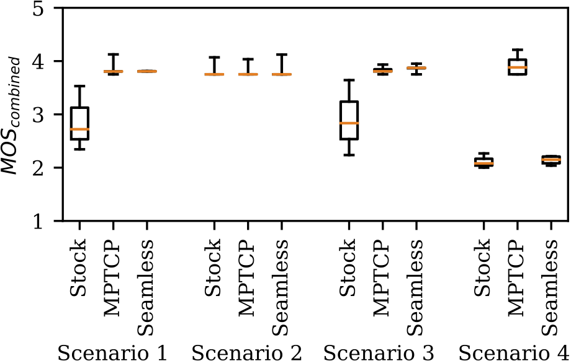
Experimental Evaluation: QoE Results
MOS_{combined} values grouped to connectivity modes and scenarios
Notes:
How to measure subjective impressions?
Mean Opinion Scores, well researched in the field of video streaming
Combination of Mean Opinion Scores
Stallings: count and length
Quality: time in highest quality
Start with 4!
Mos combined, grouped by scenario
Mos: the higher, the better
For the first three scenarios as good as mptcp (but with significantly less lte usage)
Scenario 4: seamless not so good due to the fact, that esta blished lte connections are dismantled even befor complete setup
Additionally lte within core of building not so good
Could be handled in future work: use more contextual sensors, predict wifi regain

Slide 23
Conclusion
Novel data-driven approach for Wi-Fi loss prediction
    Precision of up to 0.97; Recall of up to 0.98
Promising results with MPTCP-based handovers
    QoE improvements of 2.7 to 3.8 in certain scenarios
    Lower cellular data usage (50%) compared to traditional MPTCP handovers
Notes:
- Go through points

Slide 24
Future Work
Enlarge sensor variety: from contextual sensors to domain specific sensors, i.e., to detect high network load
Online learning on smartphones
    User-specific models, e.g., user / access point combinations
  Multi-RAT handover predictions (Wi-Fi, 3G, LTE, 5G, …)
  Hardware / low-level implementations
    Smartphone sensor hub, lightweight neural networks
Notes:
- Go through points (first point: link back to scneraio 4, last point: link to prior work like multi modal CEP)

Slide 25
One more thing…
https://umr-ds.github.io/seamcon/
Notes:
Homeage
All data available
Docker containers including jupyter notebook for reproducing results
Guides for building it yourself for further research

Slide 26
The End
Time for
Questions

Slide 27
Model Evaluation: User-based Data Split
  Full Feature Vector: 0.91, 0.72, and 0.68 precision in the Wi-Fi loss class
Reduced Feature Vector: 0.93, 0.92, and 0.79 precision in the Wi-Fi loss class
  Neural networks are capable of predicting Wi-Fi loss.
    The Reduced Feature Vector generalizes better;
    per-user training significantly improves the results.
  Overall best performance: NN 3 with the Reduced Feature Vector
Notes:
Only Prec. / Recall of Loss class
NN 1 overall comparable to Random Forest
NN 2 and NN 3 comparably good
Neural Network performs well for both cases, F-Score of 0.96

Slide 28
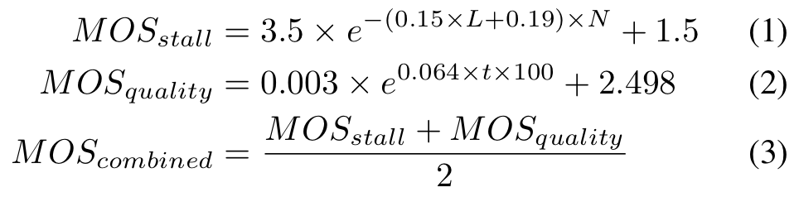
Experimental Evaluation
Mean Opinion Score as QoE Metric
Notes:
How to measure subjective impressions?
Mean Opinion Scores, well researched in the field of video streaming
Combination of Mean Opinion Scores
Stallings: count and length
Quality: time in highest quality

Slide 29
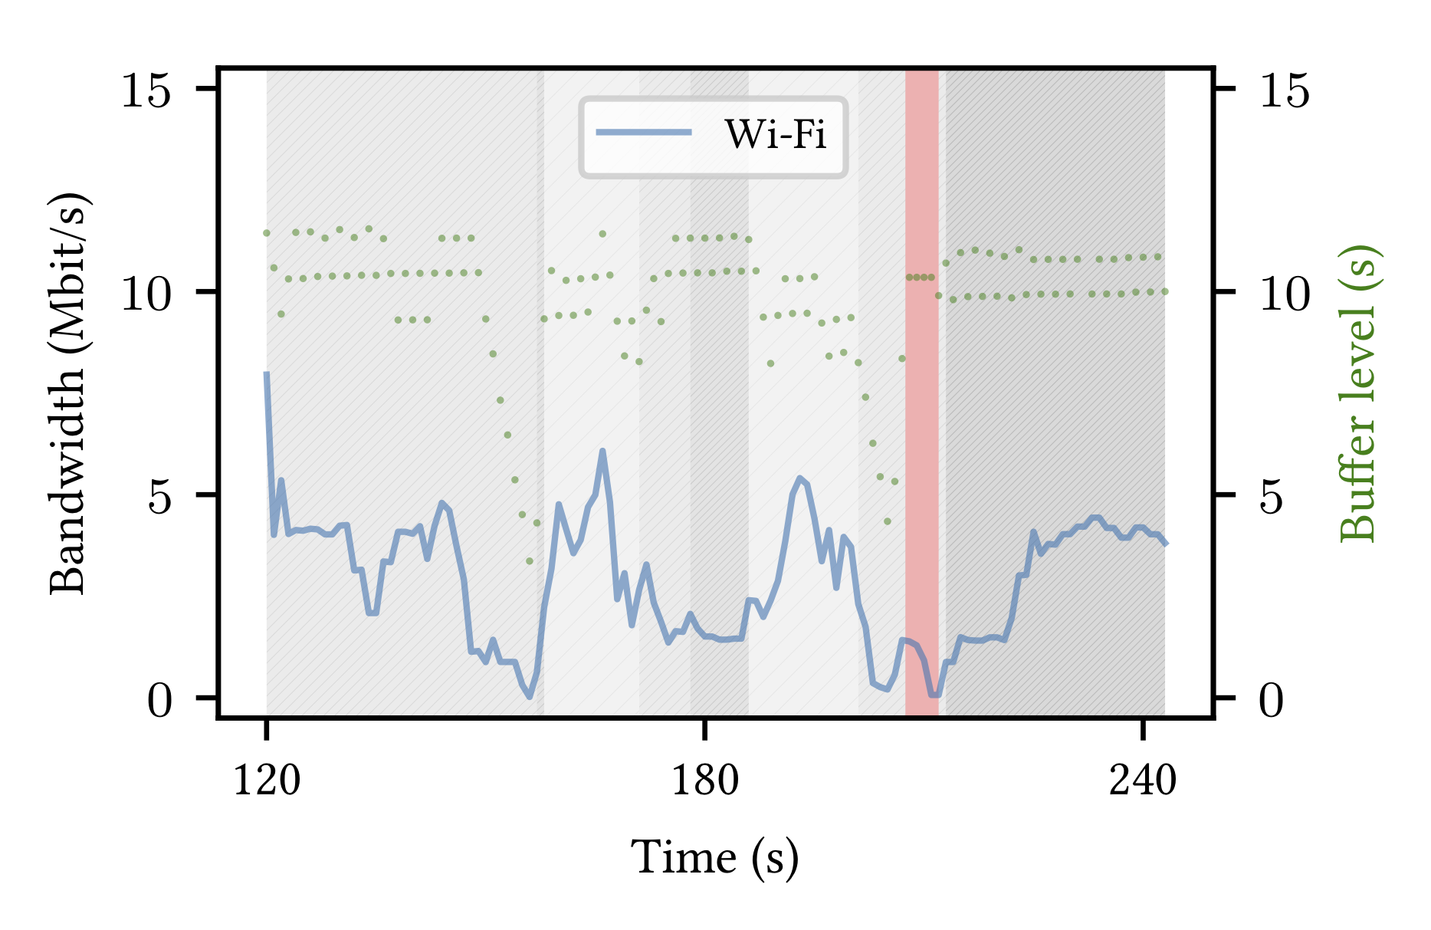
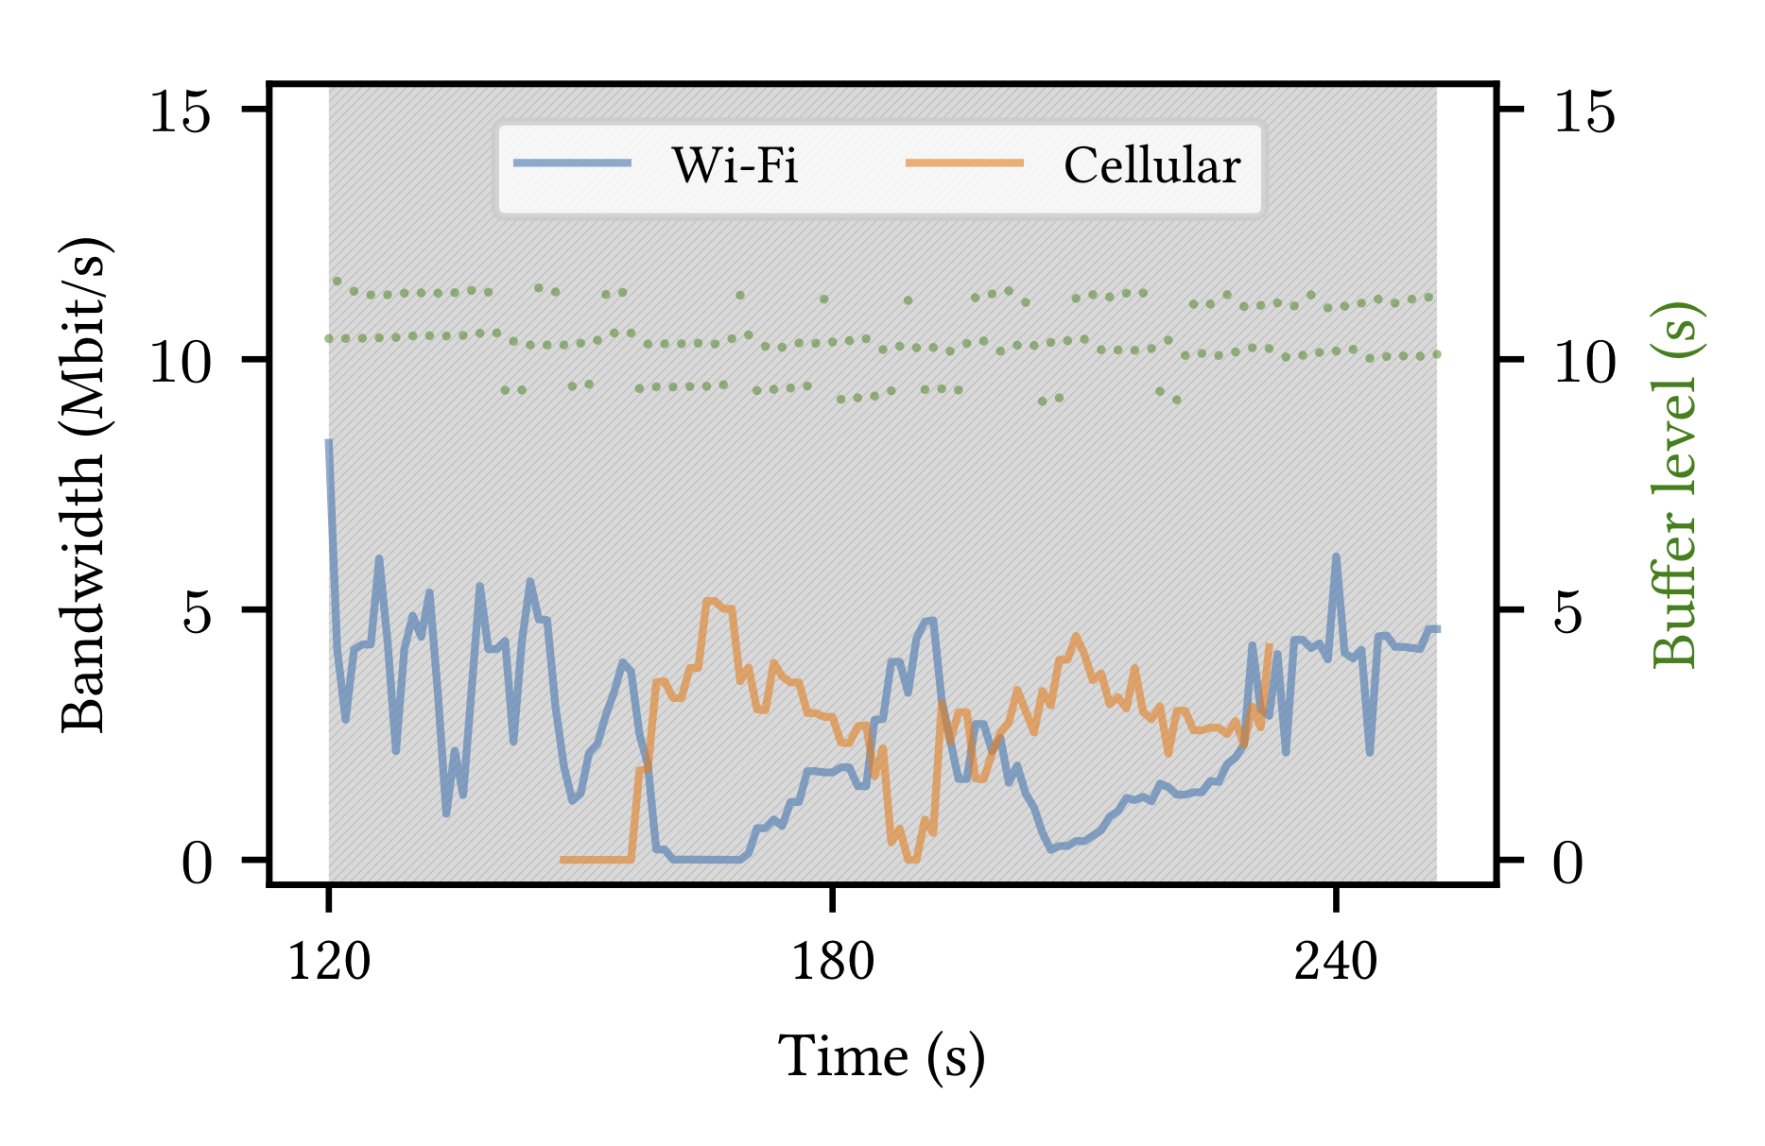
Experimental Evaluation: QoE Results
a) Stock Android
b) Seamless
Stock and Seamless in Scenario 3

Slide 30
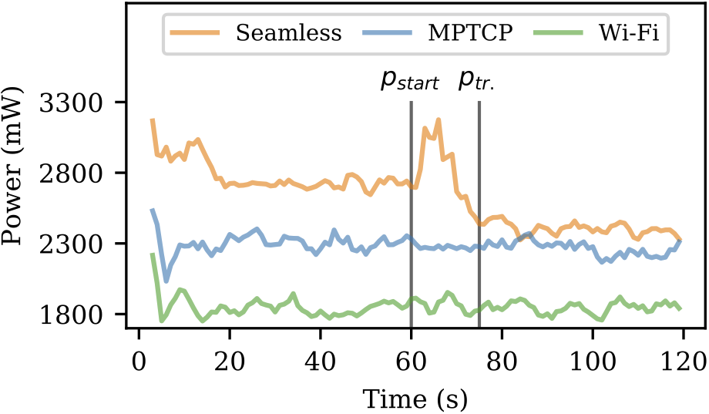
Experimental Evaluation: Power consumption
Power consumption across different connectivity modes
Notes:
Wifi: 1800 mW (145 mW).
LTE: increase 18.9% 2300 (143 mW).
First 60: pred + wifi + lte: 2800 mW 22% higher than mptcp.
Pstart: transition -> lte off, routing table
Ptr: 2400 mw (5% more than mptcp only)
Average: 15% more to retain high QoE (2600 mw)
If taken nexus 5: 30 minutes less video playback (4.5 to 4 hours)

